Slide 1
Current State of AMOEBA-Protein Stark Effect Project
Andrew Ritchie
June 16, 2015

Slide 2
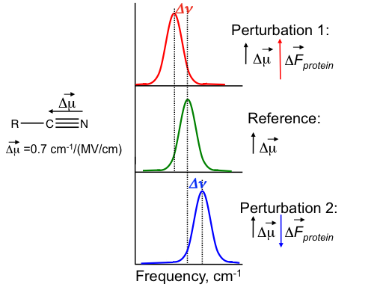
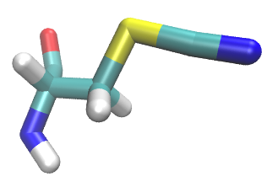
Vibrational Stark Effect (VSE)

Slide 3
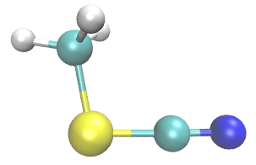
Rap &Ras docked to Ral in Amber03 with tip3p water (54 data points)

Slide 4
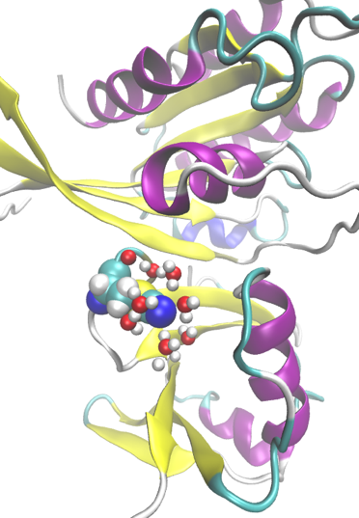
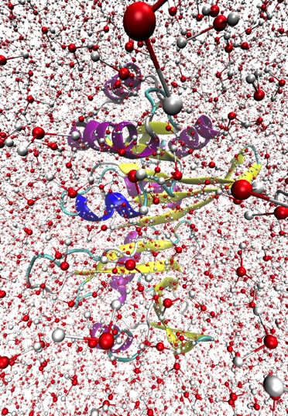
Electrostatic Models
APBS | APBS 5Å-ES | Amber03-ES
AMOEBA | AMOEBA-CP | AMOEBA-CPf
AMOEBA-ES | AMOEBA-ES-CP | AMOEBA-ES-CPf

Slide 5
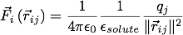
APBS and Reaction Field Method
ε_{solvent}
ε_{solute}
ε_{solvent}
-
=
ε_{solute}
ε_{solute}
ε_{solvent}
ε_{solvent}
+
=
ε_{solute}
ε_{solute}

Slide 6
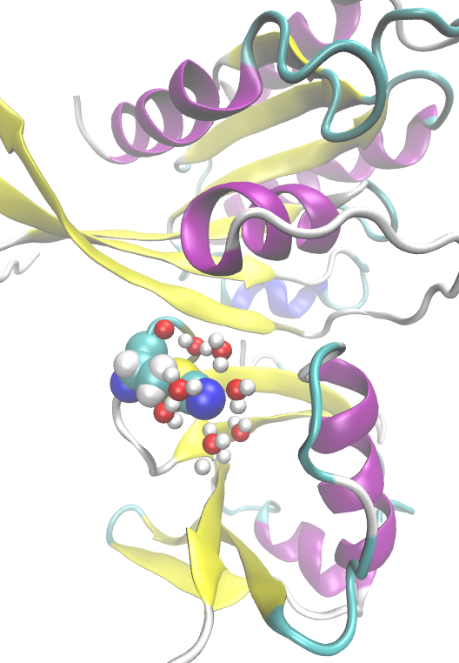
APBS 5Å-ES
ε_{solvent}
ε_{solute}

Slide 7
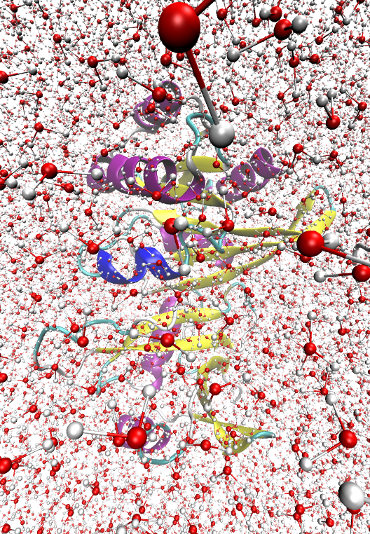
Amber03-ES

Slide 8
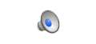
AMOEBA
Implicit Solvent with Poisson-Boltzmann
Dielectric handled using SCF induced dipole moments

Slide 9
AMOEBA-CP & AMOEBA-CPf
Interactions Include:
Core-Core
Core-Electron
Electron-Electron
Parameters either implied by atom identity (CP) or fitted from QM potentials (CPf)
Wang, et al. In Revision

Slide 10
Various Nitrile Probes on Rap E30/K31

Slide 11
Fields in Ribonuclease S
SCN pH 4.5
SCN pH 8.0
pCNF pH 4.5
pCNF pH 8.0
mCNF pH 4.5
mCNF pH 8.0
3 ns MD
3 ns REMD
Fafarman, et al., J Phys. Chem. B 2010

Slide 12
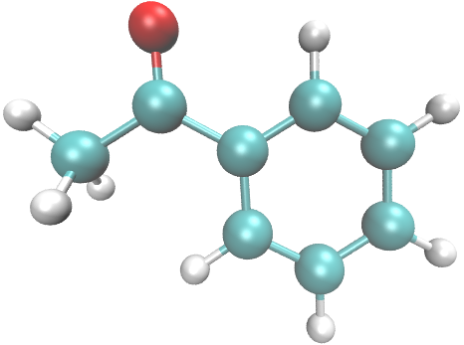
PB on small molecules in various solvents
Josh & Christina
Fried, S. D.; Bagchi, S.; Boxer, S. G. J Am Chem Soc 2013, 135 (30).

Slide 13
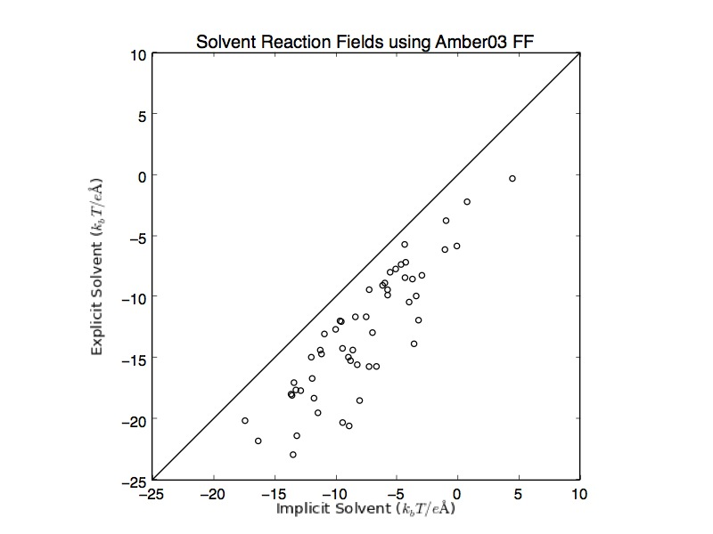
Tip3p water looks like PB continuum solvent

Slide 14
Fields on small molecules in various solvents
Fried, et al., J Phys. Chem. B 2013

Slide 15
Fields on small molecules in various solvents
“short” ~150 ps runs
SCDipoles to 10⁻⁵ D
Beeman integrator
Bussi Thermostat
Monte Carlo barostat
1 fs timestep
“long” ~1500 ps runs
SCDipoles to 10⁻³ D
RESPA integrator
Berendsen Barostat
2 fs timestep
Snapshots every 10 fs
Field averaged from induced dipoles
>= 2000 ps
SCDipoles to 10⁻⁴ D
Heavy Hydrogen
4 fs timestep
Normal Hydrogen
2.5 fs timestep
Bussi barostat
Snapshots every 1000 fs
Field averaged from induced dipoles
Field at point in space
*Note: The Fried paper does not allow the solute to polarize the solvent
Fried, et al., J Phys. Chem. B 2013

Slide 16
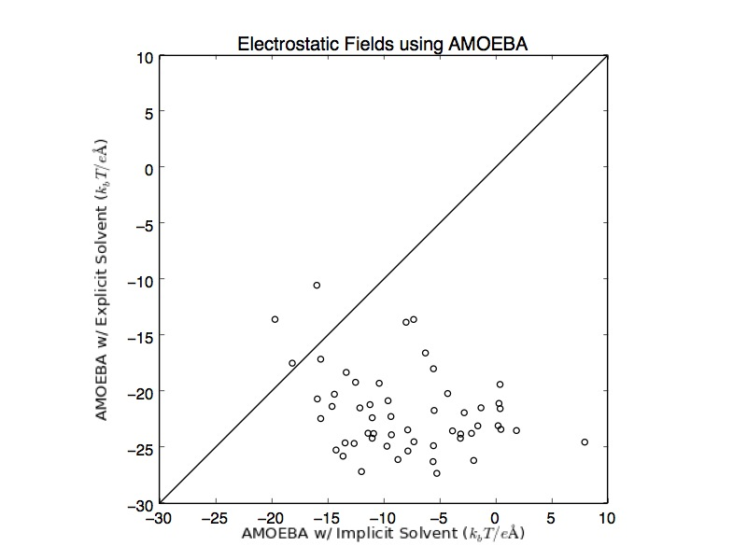
Notes:
I need to go back and reweight probabilities including AMOEBA water electrostatic potential energies

Slide 17
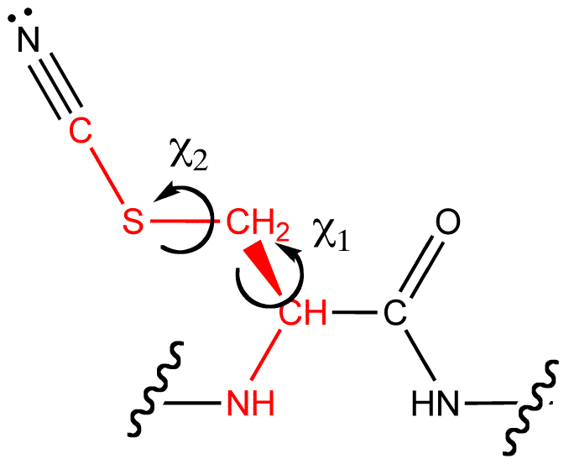
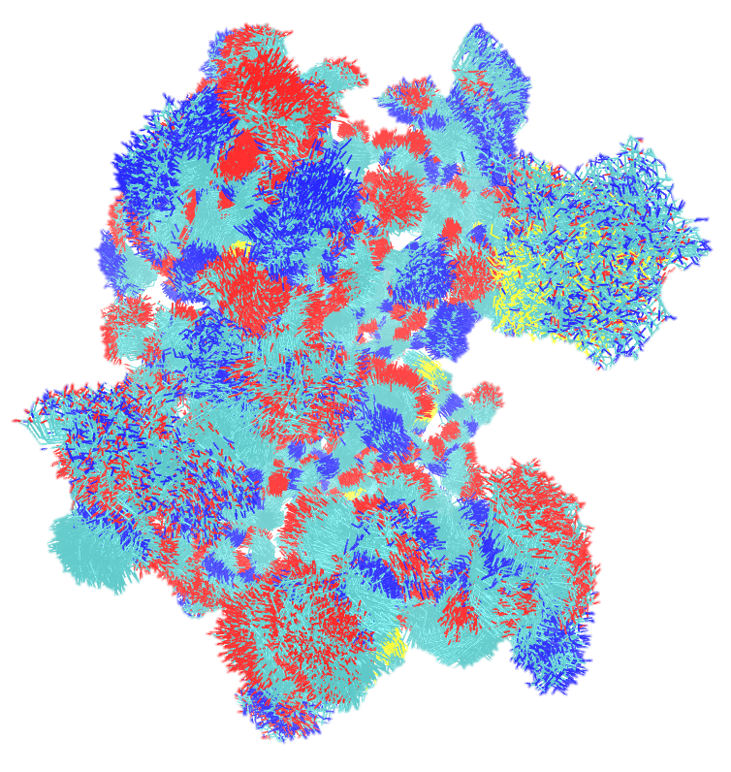
Simulating in AMOEBA
χ₂ (degrees)
χ₁ (degrees)

Slide 18
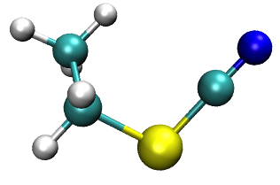
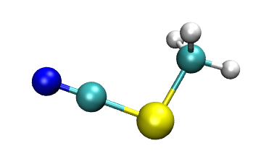
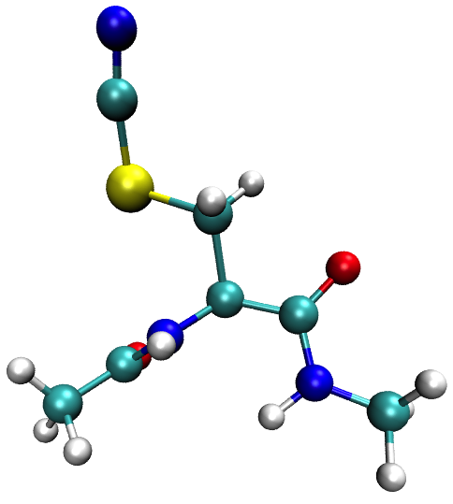
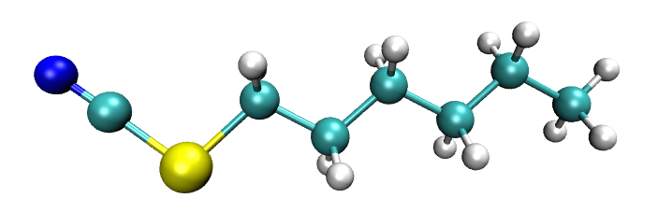
Simulating in AMOEBA
EtSCN
MeSCN
ACE-CNC-NME
HxSCN

Slide 19
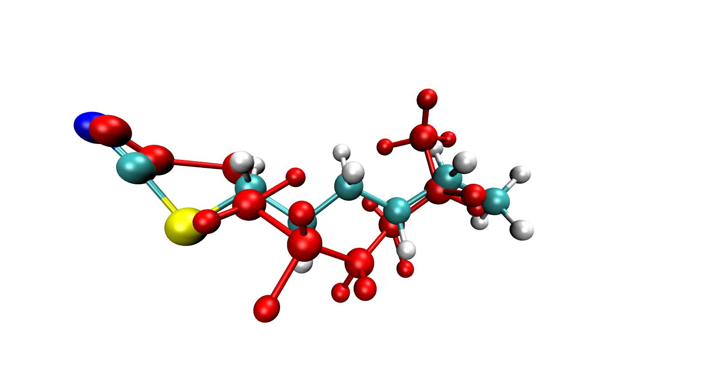
Crashing in AMOEBA
RESPA with Bussi Theromstat
Heavy Hydrogen
4 ps stepsize
Took a long time to crash
Normal Hydrogen
2.5 ps stepsize
Took a long time to crash

Slide 20
Crashing in AMOEBA
Parameters webb_amoebapro13.prm
randomseed 123456789
save-induced
save-force
archive
octahedron
vdw-cutoff 12.0
neighbor-list
ewald
ewald-cutoff 7.0
neighbor-list
integrator respa
thermostat bussi
polar-eps 0.0001
polar-predict
FFT-PACKAGE fftw
OPENMP-THREADS 16

Slide 21
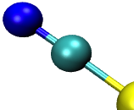
Calculated fields thus far

Slide 22
AMOEBA

Slide 23
Calculated fields thus far
No Experimental Frequency
Average Field (k_{b}T/eÅ⁻¹)
Frequency (cm⁻¹)

Slide 24
Standard deviations
No Experimental Frequency
Field Standard Deviation (k_{b}T/eÅ⁻¹)
FWHM (cm⁻¹)

Slide 25
SCN field contribution is not constant
AMOEBA –Small molecules
Amber03 - Protein
Average Total Field (k_{b}T/eÅ⁻¹)
Average Total Field – SCN Field (k_{b}T/eÅ⁻¹)

Slide 26
SCN field contribution is not constant
Average Total Field (k_{b}T/eÅ⁻¹)
Average Total Field – SCN Field (k_{b}T/eÅ⁻¹)
Average Total Field from induced dipoles (k_{b}T/eÅ⁻¹)

Slide 27
SCN field contribution is not constant
Average SCN Field (k_{b}T/eÅ⁻¹)

Slide 28
-SCN contribution is not constant

Slide 29
Calculated fields thus far

Slide 30
Calculated fields thus far

Slide 31
This does not significantly alter previous studies sampled in in Amber03

Slide 32
Comparing Water
Stdev:
0.31, 0.32
Stdev:
9.26, 1.89

Slide 33
Comparing Water

Slide 34
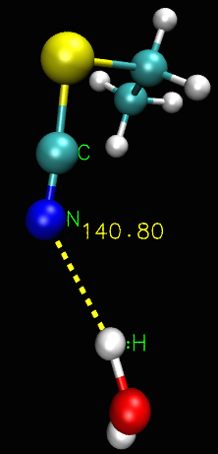
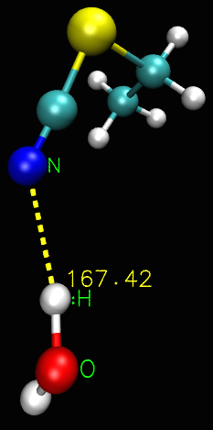
Comparing Water
C-N-H
N-H-O
2.27 Å
2.27 Å

Slide 35
In Progress: Comparing Water
Santiago currently working on production simulations of small molecules in tip3p, tip4p, and tip5p water
Calculate the fields in the different point-charge water models and comparing to AMOEBA and experiment

Slide 36
Sampling dihedral space, umbrella sampling required?
C1-C2-S-Cδ
C1-C2-C2-C3
C2-C3-C4-C5
C3-C4-C5-C6
C4-C5-C6-S
C5-C6-S-Cδ
N-C-Cβ-S
Cα-Cβ-S-Cδ

Slide 37
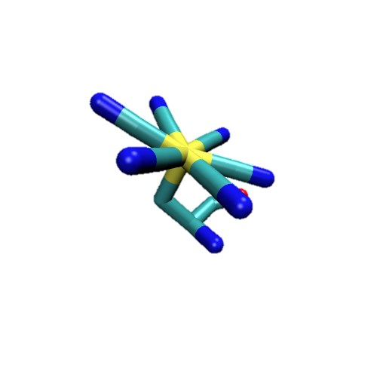
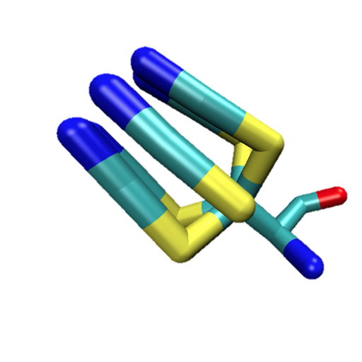
Sampling dihedral space, umbrella sampling required?

Slide 38
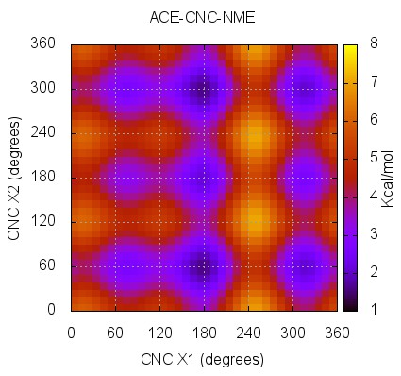
Quick Torsional Sanity Check

Slide 39
Convergence
Field (k_{b}T/eÅ⁻¹)
Time (ps)

Slide 40
In Progress: Umbrella Sampling
Work with Jeremy to establish a protocol consistent with previous work
Determine “good” biasing force constants along dihedral space
All CNC-containing peptides ACE-CNC-NME

Slide 41
The following slides are new
Dr. Ren suggested I take the multipoles on SCN from one of the parameterizations and fix the SCN multipoles on the other molecules and re-optimize. In this way, MeSCN, EtSCN, HxSCN, and CNC all have the same SCN multipole parameters, and the only thing different is what they are bound to. Here are the results thus far.
There is another bit of information added. I previously have removed the SCN contribution to the field from the total field. This results in the field being reported only being the part due to the probe environment, and not the probe itself. One of the things we observed was that the SCN field was not constant, hence the re-parameterization previously mentioned. When I looked at the sort of plot on slide 27, the monopole and quadrupole contributions were very similar. While the dipole contributions were significantly closer to each other than previously, they were less so than the other monopoles and quadrupoles. The reason for that is the dipole has 2 contributions, the permanent and the induced. The permanent dipole contribution to field is approximately equal for all molecules (slide 42). So now, in addition to showing the (total – SCN) field, I’m also showing the (total - SCN permanent only), where the SCN induced dipole field contribution is included.
3 ns MeSCN, EtSCN, HxSCN (2 fs timestep), 4 ns ACE-CNC-NME

Slide 42
SCN field contribution is now relatively constant
PERMANENT DIPOLE ONLY
Average SCN Field (k_{b}T/eÅ⁻¹)

Slide 43
Calculated fields
No Experimental Frequency
Average Field (k_{b}T/eÅ⁻¹)
Interestingly, if we remove the SCN contribution to the field, the slope is negative. If we allow the probe to polarize (ie: include the induce dipole SCN part of the field), then we recover the expected positive slope. A possible reason why the Amber03 calculations show the wrong slope?
Frequency (cm⁻¹)

Slide 44
Standard deviations
No Experimental Frequency
Field Standard Deviation (k_{b}T/eÅ⁻¹)
In the new simulations, I saved snapshots more frequently. Maybe I just wasn’t doing a good enough job including the water ensembles (incidentally, the fixed data points also had more snapshots per ps, but I didn’t think about that initially
FWHM (cm⁻¹)

Slide 45
Removing the permanent part of the SCN field is approximately removing a constant from the total field
AMOEBA –Small molecules
Amber03 - Protein
Average Total Field (k_{b}T/eÅ⁻¹)
Average Total Field – SCN Field (k_{b}T/eÅ⁻¹)

Slide 46
SCN field contribution is not constant
Average Total Field (k_{b}T/eÅ⁻¹)
Average Total Field – SCN Field (k_{b}T/eÅ⁻¹)
Average Toal Field (k_{b}T/eÅ⁻¹)
Average Total Field from induced dipoles (k_{b}T/eÅ⁻¹)
Average Total Field – SCN Field Perm Only (k_{b}T/eÅ⁻¹)
Field (k_{b}T/eÅ⁻¹)

